Slide 1
NVM/NVMe/NVDIMM/RDMA
Guoqing Jiang
gqjiang@suse.com

Slide 2
Contents
    NVM
    NVMe
    RDMA
    PMEM/NVDIMM
    NVM Programming Model

Slide 3
NVM
Non-volatile memory or non-volatile storage is a type of computer memory that can retrieve stored information even after having been power cycled. In contrast, volatile memory needs constant power in order to retain data.
There are three distinct storage types:
1. NVS: traditional Non-Volatile Storage in mechanical disks – Hard disk, Solid State Drive, Optical disk, floppy disk, etc.
2. NVM: storage in Non-Volatile Memory chips (Flash memory Storage) – EEPROM, SSD, NAND, etc.
3. NVMM: storage inside Non-Volatile Main Memory chips (Re-RAM) – NVDIMM-P, specifications to be released 2018.

Slide 4
NVMe
NVM Express (NVMe) or Non-Volatile Memory Host Controller Interface Specification (NVMHCIS) is an open logical device interface specification for accessing non-volatile storage media (mostly for SSD) attached via a PCI Express (PCIe) bus - Wiki
NVM Express (NVMe) is an interface that allows host software to communicate with a non-volatile memory subsystem. This interface is optimized for Enterprise and Client solid state drives, typically attached as a register level interface to the PCI Express interface
- NVMe 1.3b spec

Slide 5
NVMe
Historically, SSDs used buses such as SATA/SAS etc for interfacing with the rest of a computer system. However, SATA was designed primarily for interfacing with mechanical hard disk drives (HDDs), and it became increasingly inadequate for SSDs, which improved in speed over time. High-end SSDs had been made using the PCI Express bus before NVMe, but using non-standard specification interfaces. Similar as USB mass storage, standardizing the interface of SSDs, OS only need one driver to work with all SSDs adhering to the specification.

Slide 6
NVMe queue
NVMe uses queues mechanism to deliver message, and it has two types of queues:
• Admin Queue for Admin Command Set
  - One per NVMe controller with up to 4K elements per queue
  - Used to configure IO Queues and controller/feature management
• I/O Queues for IO Command Sets (e.g., NVM command set)
  - Up to 64K queues per NVMe controller with up to 64K elements per queue
  - Used to submit/complete IO commands
NVMe uses circular queues to pass messages (e.g., commands and
command completion notifications.). The queues may be located
anywhere in PCIe memory.

Slide 7
NVMe queue
Both admin queue and I/O queue have two type queues:
1. submission queues (SQ)
  Queues messages from host to controller
  Used to submit commands
  Identified by SQ ID
2. completion queues (CQ)
  Queues messages from controller to host
  Used to post command completions
  Identified by CQ ID
  May have an independent MSI-X interrupt per completion queue
For SMP, each core can have its own queue and no need for competing one command queue like sata, so this is the motivation for blk-mq?

Slide 8
Linux NVMe
NVMe target works like iSCSI target, it could be connect to host by RDMA or FC. NVMe host (actually client) could connect to a remote NVMe target ( by FC or RDMA) or local storage through PCIe interface?
gqjiang@linux-8mgw:~/source-tree/linux> ls drivers/nvme
host Kconfig Makefile target
gqjiang@linux-8mgw:~/source-tree/linux> ls drivers/nvme/target/
admin-cmd.c configfs.c core.c discovery.c fabrics-cmd.c fc.c fcloop.c io-cmd.c Kconfig loop.c Makefile nvmet.h rdma.c
gqjiang@linux-8mgw:~/source-tree/linux> ls drivers/nvme/host/
core.c fabrics.c fabrics.h fault_inject.c fc.c Kconfig lightnvm.c Makefile multipath.c nvme.h pci.c rdma.c trace.c trace.h

Slide 9
Linux NVMe
NVMe target works like iSCSI target, it could be connect to host by RDMA or FC. NVMe host (actually client) could connect to a remote NVMe target ( by FC or RDMA) or local storage through PCIe interface?
gqjiang@linux-8mgw:~/source-tree/linux> ls drivers/nvme
host Kconfig Makefile target
gqjiang@linux-8mgw:~/source-tree/linux> ls drivers/nvme/target/
admin-cmd.c configfs.c core.c discovery.c fabrics-cmd.c fc.c fcloop.c io-cmd.c Kconfig loop.c Makefile nvmet.h rdma.c
gqjiang@linux-8mgw:~/source-tree/linux> ls drivers/nvme/host/
core.c fabrics.c fabrics.h fault_inject.c fc.c Kconfig lightnvm.c Makefile multipath.c nvme.h pci.c rdma.c trace.c trace.h

Slide 10
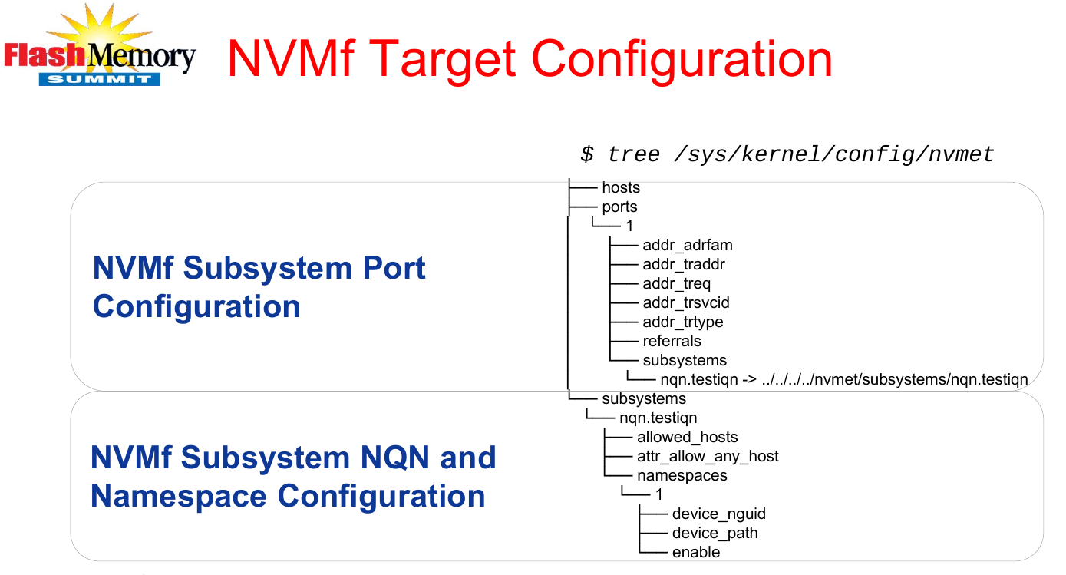
Linux NVMe

Slide 11
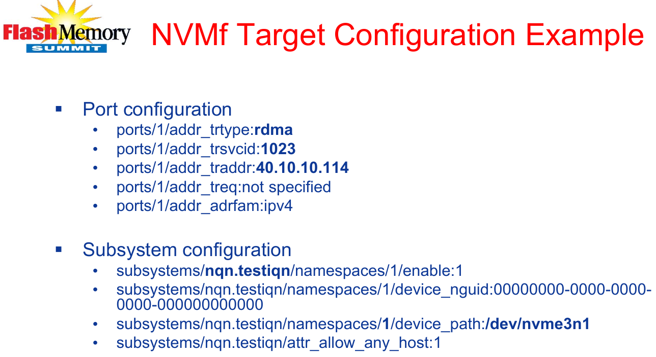
Linux NVMe

Slide 12
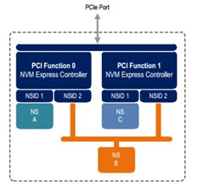
NVMe subsystem (target side)
Subsytem includes one or more controllers, one or more namespaces, one or more PCI Express ports, a non-volatile memory storage medium, and an interface between the controller(s) and non-volatile memory storage medium.
A Controller is associated with a single PCI
Function.
A namespace is quantity of NVM physical
memory wrapped as a logic block.
Port is exported to NVMe Client (Initiator)
to create connection.

Slide 13
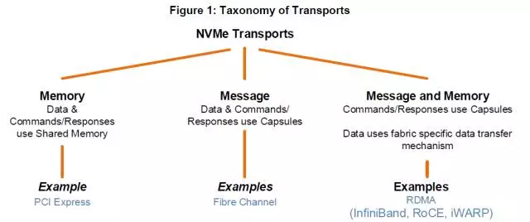
NVMe over Fabric
Besides local connection method (PCIe) to NVM device, we can access remote NVM device through fabric, NVMe over Fabric includes: NVMe over FC (Fabric channel) and NVMe over RDMA.

Slide 14
RDMA
RDMA is a direct memory access from the memory of one computer into that of another without involving either one's operating system. This permits high-throughput, low-latency networking, which is especially useful in massively parallel computer clusters.
RDMA supports zero-copy networking by enabling the network adapter to transfer data directly to or from application memory, eliminating the need to copy data between application memory and the data buffers in the operating system.

Slide 15
RDMA
The major implementation of RDMA includes RDMA over Converged Ethernet (RoCE), InfiniBand and iWarp.
InfiniBand refers to two distinctly different concepts:
  A physical link-layer protocol for InfiniBand networks
  A higher-level programming API called the InfiniBand Verbs API
InfiniBand需要依赖于专用的InfiniBand网络，因此可以提供非常好的服务质量，而RoCE和iWarp则可以基于以太网络，并使用专用的RDMA NIC和Switch来实现高服务质量。RoCE的两个版本中，v2依赖于UDP/IP协议提供了>在局域网中灵活的路由和拥塞控制功能; iWarp则是基于TCP协议提供了更加灵活的网络互联方式.

Slide 16
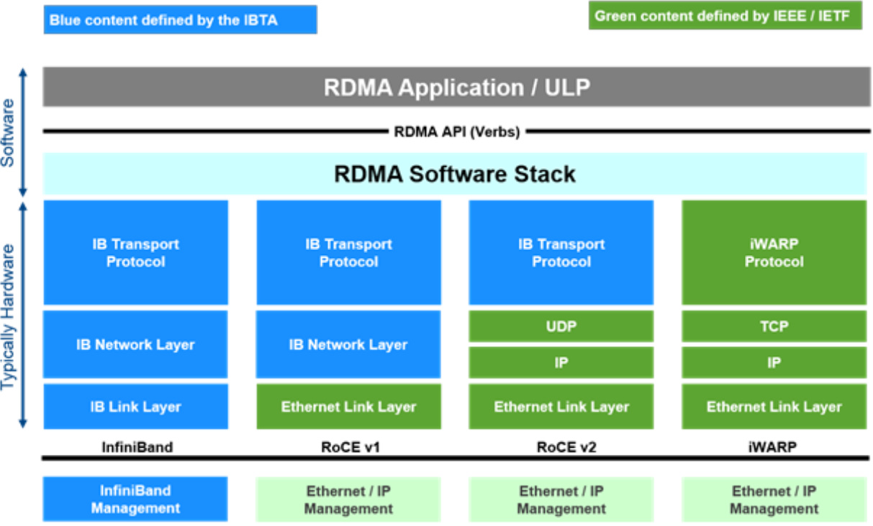
RDMA

Slide 17
RDMA
User Application
OFA Verbs API
OSI
Layers
RDMAP
DDP
Transport
MPA
IB Transport API
TCP
IB Transport
Network
IP
IB Network
Data Link
Ethernet MAC & LLC
IB Link
Physical
Ethernet PHY
IB PHY
CA
IWARP “RNIC”
RoCE “NIC”
InfiniBand “HCA”

Slide 18
RDMA RoCE
RDMA over Converged Ethernet (RoCE) is a network protocol that allows remote direct memory access (RDMA) over an Ethernet network.
• Provide InfiniBand-like performance and efficiency to ubiquitous
Ethernet infrastructure.
• Utilize the same transport and network layers from IB
• InfiniBand stack and swap the link layer for Ethernet.
• Implement IB verbs over Ethernet.

Slide 19
RDMA RoCE
There are two RoCE versions, RoCE v1 and RoCE v2.
RoCE v1(Layer 2)运作在Ehternet Link Layer(Layer 2)所以Ethertype 0x8915，所以正常的Frame大小为1500 bytes，而Jumbo Frame则是9000 bytes。
RoCE v2(Layer 3)运作在UDP/IPv4或UDP/IPv6之上(Layer 3)，采用UDP Port 4791进行传输。因为 RoCE v2的封包是座落在 Layer 3之上可进行路由，所以有时又会称为「Routable RoCE」或简称「RRoCE

Slide 20
RDMA softRoCE
不同于RoCE,softRoCE适用于任何以太环境，无需依赖NIC, switch, L2QoS等支持。
softRoCE的目标是在所有支持以太网的设备上都可以部署RDMA传输，其实现可分成两部分，对上通过librxe与RDMA stack（libibverbs）耦合，对下通过rxe.ko与linux stack layer3耦合，用户通过某个eth NIC的UDP隧道为虚拟的RDMA设备传输RoCE数据。

Slide 21
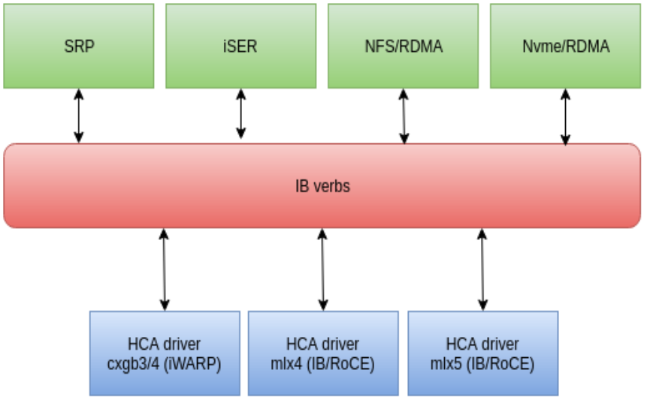
Linux RDMA
ULP
RDMA
Core layer
Device drivers
The InfiniBand Verbs API (IB verbs) - an implementation of a remote direct memory access (RDMA) technology.
ULP – Upper layer protocol
HCA – host channel adapter, it is IB counterpart of NICs.
SRP – SCSI RDMA Protocol iSER – iSCSI Extensions for RDMA

Slide 22
Linux RDMA
The source code for RDMA are in:
  drivers/infiniband/core/ - core layer
  drivers/infiniband/hw/ - hardware device drivers
  drivers/infiniband/sw/ - software drivers (e.g. Soft-RoCE)
  drivers/infiniband/ulp/ - ULP modules
The header files are located in include/rdma and include/uapi/rdma.
Also, userspace package libibverbs is needed.

Slide 23
PMEM
In computer science, persistent memory is any method or apparatus for efficiently storing data structures such that they can continue to be accessed using memory instructions or memory APIs even after the end of the process that created or last modified them.[1]
Often confused with non-volatile random-access memory (NVRAM), persistent memory is instead more closely linked to the concept of persistence in its emphasis on program state that exists outside the fault zone of the process that created it.
                - Wiki Persistent memory

Slide 24
PMEM
For many years computer applications organized their data between two tiers: memory and storage. The emerging persistent memory technologies introduce a third tier.
Persistent memory (or pmem for short) is accessed like volatile memory, using processor load and store instructions, but it retains its contents across power loss like storage.
PMEM is a type of Non-Volatile Memory (NVM).

Slide 25
PMEM
Persistent Memory is byte addressable, which means individual memory addresses can be written with load/store instructions, whereas block addressability means using read/write instructions that access an entire block of data at the same time.
Persistent Memory is emerging as a technology that combines DRAM and NAND to accelerate I/O on the memory bus. Put simply, PM can be thought of as persistent storage in a DIMM slot. Hence we see the name NVDIMM or Non-Volatile DIMM being used.

Slide 26
NVDIMM
A non-volatile dual in-line memory module (NVDIMM) is a type of random-access memory for computers. Non-volatile memory is memory that retains its contents even when electrical power is removed, for example from an unexpected power loss, system crash, or normal shutdown. "Dual in-line" identifies the memory as using the DIMM package.
There are three types of NVDIMM implementations by JEDEC Standards org: NVDIMM-F, NVDIMM-D and NVDIMM-P.
The Linux source code is inside drivers/nvdimm.

Slide 27
NVDIMM-N
DIMM with flash storage and traditional DRAM on the same module. The computer accesses the traditional DRAM directly. In the event of a power failure, the module copies the data from the volatile traditional DRAM to the persistent flash storage, and copies it back when power is restored. It uses a small backup power source for this.
Currently the most popular and only product available on the market today, with capacities of 8, 16 and 32GB. An NVDIMM-N device can be written to as either a block or byte-addressable device.

Slide 28
NVDIMM-F
DIMM with flash storage. System users will need to pair the storage DIMM alongside a traditional DRAM DIMM.
This variation uses flash storage as the only storage medium. It provides block-level addressability to flash storage, with an onboard controller performing the translation task from system memory requests to the NAND storage.

Slide 29
NVDIMM-P
NVDIMM-P specifications will be released by JEDEC around 2018. It will allow storage inside computer main memory, using ReRAM technology, and a DDR5 interface. A NVDIMM-P has persistent DRAM, and can access external block-oriented (flash memory) drive for memory cache.
The third variation uses both DRAM and NAND, with significantly more NAND than DRAM. Although standards for NVDIMM-P haven’t been fully released, the implication is that the DRAM acts as a cache and either optimises writes to/from the NAND part or is used to improve latency.

Slide 30
NVDIMM
What purposes do the three products serve?
  NVDIMM-N delivers DRAM-level performance and simply adds persistence, but will be more expensive than DRAM because of the additional NAND and controller. So the extra cost here is for persistence.
  NVDIMM-F provides greater capacity and persistence at the expense of performance, but at lower pricing than DRAM.
  Bridging the gap is NVDIMM-P, which should be cheaper than DRAM (due to the ratio of NAND and DRAM onboard), offer persistence and near-DRAM performance.

Slide 31
NVDIMM
Disk-like NVDIMMs (Type F or P)
  Appear as disk drives to applications
  Accessed using disk stack
Memory-like NVDIMMs (Type N or P)
  Appear as memory to applications
  Applications store variables directly in RAM
  No IO or even DMA is required
Memory-like NVDIMMs are a type of persistent memory

Slide 32
3D XPoint
3D XPoint (pronounced three dee cross point) is a non-volatile memory (NVM) technology by Intel and Micron Technology; Initial prices are less than dynamic random-access memory (DRAM) but more than flash memory. There are SSD and DIMM memory modules based on 3D Xpoint technology.
3D XPoint (is a NVM technology) DIMMs will require server platform support because they are unlikely to operate as standard DDR4 DIMMs Intel and Micron extending the (DDR4) interface to support 3D XPoint DIMMs, so it is a proprietary approach.

Slide 33
DAX
The page cache is usually used to buffer reads and writes to files.
It is also used to provide the pages which are mapped into userspace
by a call to mmap.
For block devices that are memory-like, the page cache pages would be unnecessary copies of the original storage. The DAX code removes the extra copy by performing reads and writes directly to the storage device. For file mappings, the storage device is mapped directly into userspace.

Slide 34
DAX
The DAX code currently only supports files with a block size equal to your kernel's PAGE_SIZE specially optimized for RAM based storage, avoids an extra copy-between-kernel step.
Linux DAX is a replacement for the variation of XIP (execute in place).
See drivers/dax.

Slide 35
NVM programming model
Current programming model:
  Data records are created in volatile memory
  Memory operations
  Copied to HDD or SSD to make them persistent I/O operations
Opportunities provided by NVM devices:
  Software to skip the steps that copy data from memory to disks.
  Software can take advantage of the unique capabilities of both
  persistent memory and flash NVM
Need for a new programming model
  Application writes persistent data directly to NVM which can be treated just like RAM

Slide 36
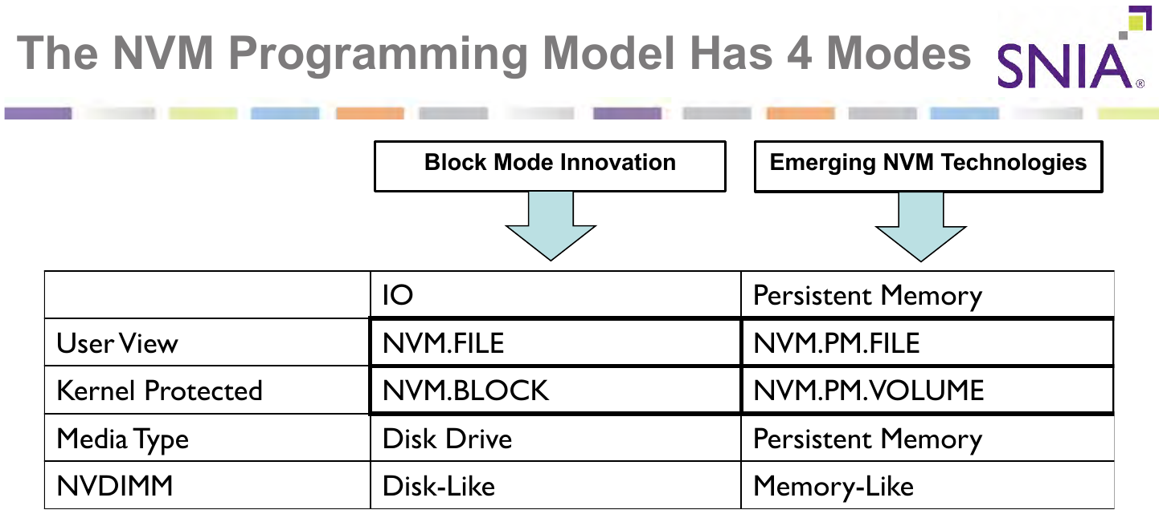
NVM programming model

Slide 37
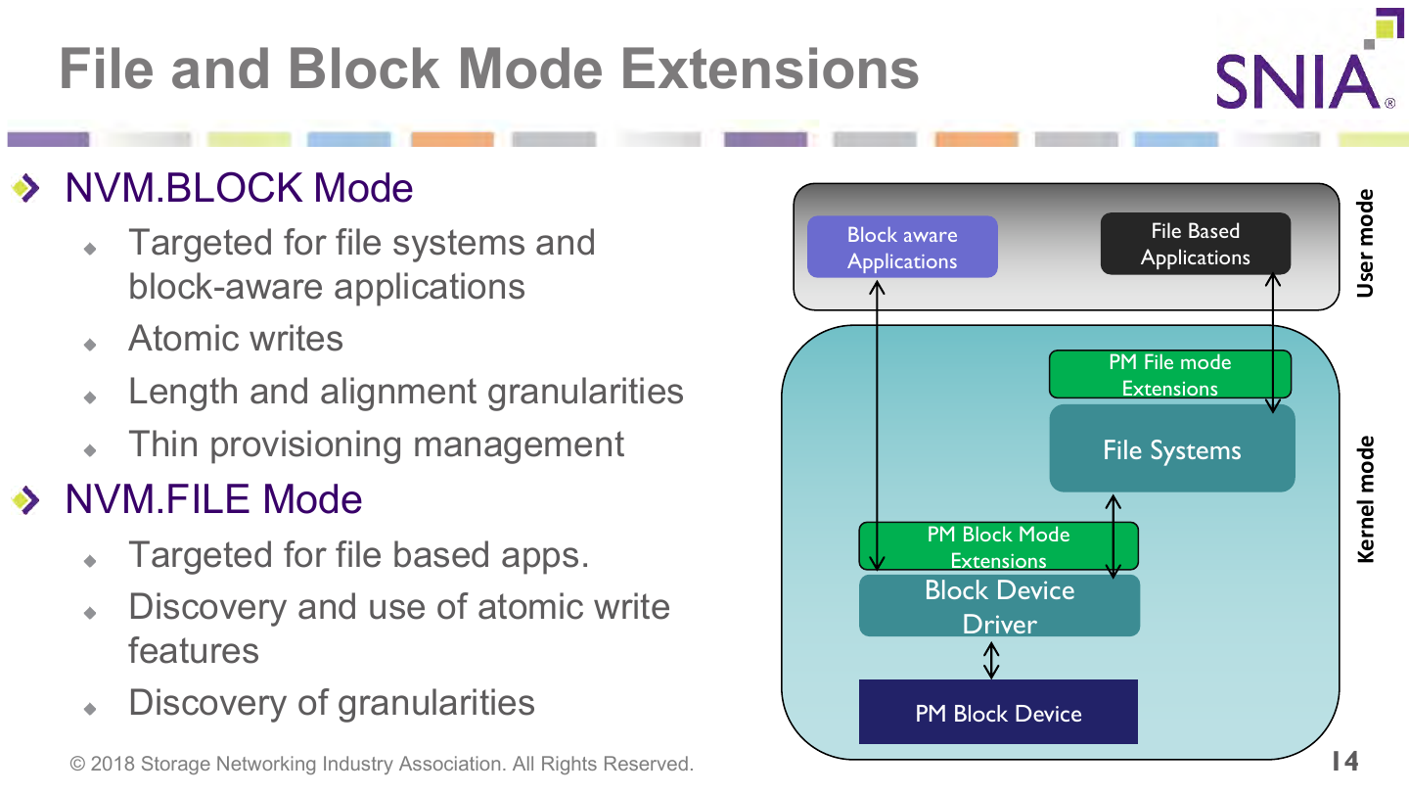
NVM programming model

Slide 38
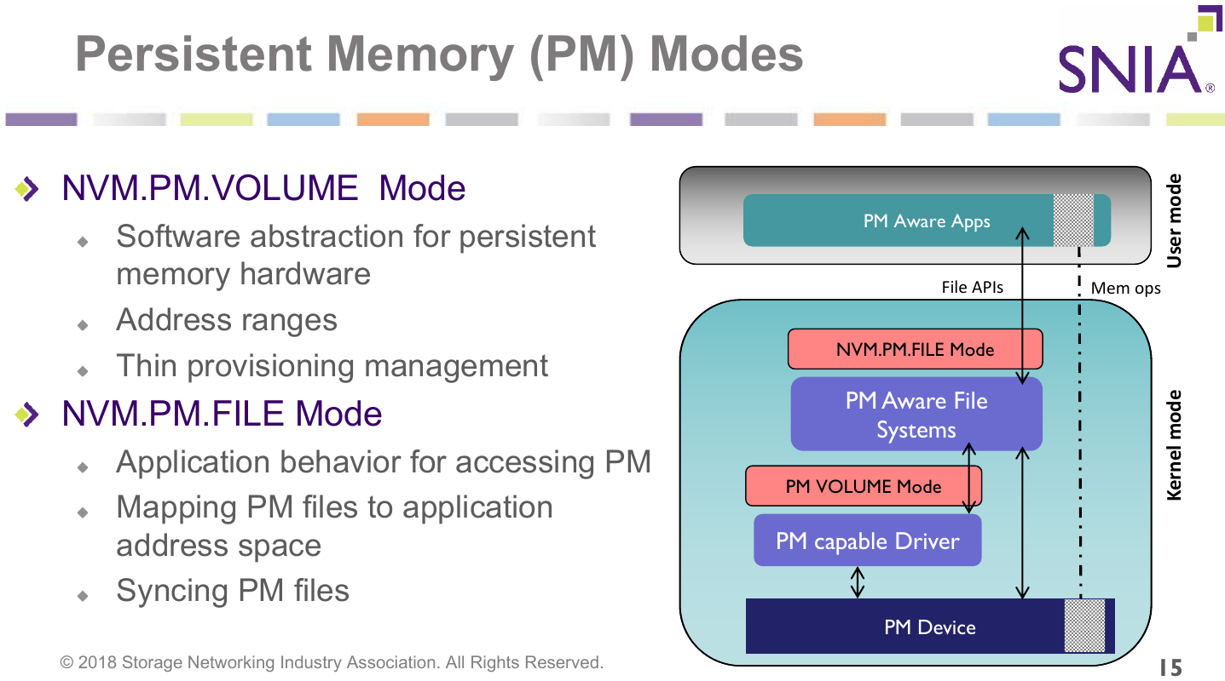
NVM programming model

Slide 39
Further readings
https://en.wikipedia.org/wiki/NVM_Express
https://en.wikipedia.org/wiki/RDMA_over_Converged_Ethernet
http://linux-iscsi.org/wiki/InfiniBand
https://access.redhat.com/documentation/en-us/red_hat_enterprise_linux/7/html/networking_guide/sec-configuring_soft-_roce
http://www.cnblogs.com/rodenpark/p/6220519.html
http://www.cnblogs.com/echo1937/p/7018266.html
https://community.mellanox.com/docs/DOC-2504
https://en.wikipedia.org/wiki/Persistent_memory
https://en.wikipedia.org/wiki/NVDIMM
https://www.snia.org/sites/default/files/technical_work/final/NVMProgrammingModel_v1.2.pdf
NVMe 1.3b spec

Slide 40
Question?

